Slide 1
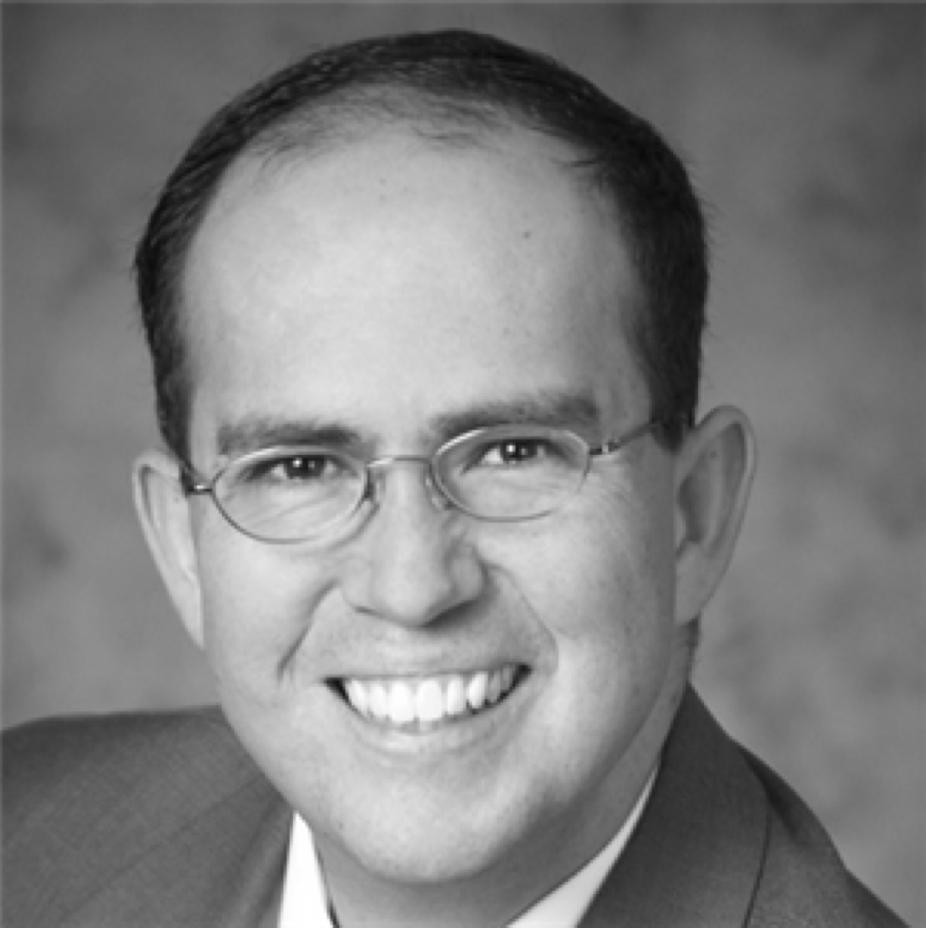
Improve Your Active Listening Skills
Jason Alba
@jasonalba www.JibberJobber.com

Slide 2
What is active listening?
Can you teach someone else?
Body language
Eye contact
Their tone
Responding during the conversation
Taking notes
Your personal debrief
Biting your tongue
The power of follow-up
Pause and plan
Overview

Slide 3
What is Active Listening?
Active listening
Passive listening
Body language is engaged
Eye contact
Periodic responses
Clarifying questions
Relevant questions
Patience (not a contest to talk)
Distractions (TV, email, smart phone)
Looking over the shoulder
Repeatedly asking to repeat
Disinterested feedback (um-hm)
Wrong answers or poor questions
Anxious to interrupt

Slide 4
Can You Teach Someone Else?
Whether you can or not…
If you listen well, you should be able to teach others
You should retain more, understand deeper, and be a better, more engaged listener
Try it: tell someone about a conversation you had with someone else
Try it: ask a participant what the most important things were from a meeting

Slide 5
Body Language

Slide 6

Listen with Your Eyes
Watch their mannerisms
What do they do with their hands (excitement level)?
Where are they looking (deception, lack of clarity)?
How are their arms (crossed can mean being closed)?
Are they dancing around (nervous)?
And… what is your body language saying?

Slide 7
Listen with Your Eyes
Engage them with eye contact – will keep them looking at you (unless they are lying, feel guilty, are ashamed, etc.)
NOTE: that is a generalization! Don’t call someone out on that… maybe that is their personality!
Don’t drill a hole through them with your eyes
Don’t make them feel like they are being interrogated

Slide 8
Eye Contact
Hello! Are you there?
Not creepy
Not too much
Definitely not too little
Don’t follow distractions (other people, any part of their clothes, body, the TV, your watch or phone, etc.)

Slide 9
Their Tone

Slide 10

What Does Their Tone Say?
Where are they emotionally (stressed, excited, bored, etc.)?
Do they believe what they are saying?
Is there a sense of urgency?
Will you need to resolve this immediately?
Do they trust you by sharing secret information?

Slide 11
Emotions Expressed with Tone
Stressed
Excited
Bored
Scared
I believe what I’m saying

Slide 12
Emotions Expressed with Tone
I don’t believe what I’m saying
Sense of urgency
I trust you
I don’t trust you
Forced

Slide 13
Responding During the Conversation

Slide 14

How to Respond Appropriately
Well-timed, appropriate, interested "m-hm"
Nodding or shaking your head
Mirror their emotions and body language
Ask clarifying questions
Respond to (even acknowledge!) their responses
Sum up: “Let me see if I understand you correctly… are you saying [insert your own words here]?”

Slide 15
Other Ways to Say That
“Let me see if I understand you correctly… are you saying [insert your own words here]?”
“Do you mean to say _________?”
“Are you saying that _________?”
“Are you implying _________?”
“Are you telling him that _________?”

Slide 16






Taking Notes
What and when to write:
Don’t let your note taking become a distraction
Notes on the phone might say "I'm on Facebook, too!"
Jot down the main points of the conversation
Writing everything might mean you miss part of the conversation
Create special annotation for follow-up (action items)
Write more details once the conversation is over

Slide 17

Your Personal Debrief
This should be written:
Summary of conversation
What did you learn?
What did you think about the conversation and information?
How would you do things differently?
What do you need to follow-up on?

Slide 18
Biting Your Tongue

Slide 19


Biting Your Tongue
This is not a contest
Do not focus so much on your response or ideas that you (a) don’t listen, or (b) maybe worse, interrupt

Slide 20

Resist the Need to Interrupt
It is not a race
If you forget your thoughts/ideas, figure out a system
“I don’t remember what I was going to say,” or
Write your points down, so you don’t forget
Interrupting is a big sign of “I don’t care… let me talk”
Be prepared so you can focus more on their message and body language, and respond appropriately

Slide 21
Resist the Need to Interrupt
Know what your main objectives are
Are some of your talking points tangents or distractions to your main objectives?
Avoid the temptation to respond eloquently in your mind while they are still talking (you might miss stuff)

Slide 22

Resist the Need to Interrupt
Be ready to not get all of your points across
Save them for a later conversation
Email the points later
Maybe they are less relevant as the conversation progresses
It’s not about winning
“He who talks first, loses”

Slide 23
The Power of Follow-up

Slide 24
Follow-up Can…
Show your interest level in the topic
Show your level of commitment on the project
Build more trust in the relationship
Show they can trust you with more (work, info, contacts, introductions, referrals, etc.)

Slide 25

Follow-up Can Be…
A quick, simple email
A comprehensive summary (email)
A phone call or voice mail
A gift, article, or something else with “thought”
A report back (“return and report”)

Slide 26
Pause and Plan

Slide 27

When Will You Practice This?
Identify a situation
What will you specifically work on?
Removing distractions
Reading body language
Eye contact
Etc.
When will you do this?

Slide 28


When Will You Practice This?
One-on-one conversation
“I will work on watching the person's face and body language, in a non-creepy way.”

Slide 29


When Will You Practice This?
Information meeting
“I’m going to summarize the main points, list my action items, and then repeat to a colleague what the meeting was about and what I got out of it.”

Slide 30


When Will You Practice This?
Weekly planning meeting
”I will list who talks, what their main projects are, issues or suggestions brought up, and what appropriate follow-up should be.”

Slide 31

When Will You Practice This?
When talking with someone
“I will repeat and clarify what they say.”
(This will seem uncomfortable, but try this five times this week: “do you mean to say…” or “are you saying…” or “is there anything I missed?”)

Slide 32


When Will You Practice This?
Watching another Pluralsight course
“I will remove all distractions, take meaningful notes, and leave a comment in the discussion box with one or two things I have learned, and how that will help me.”

Slide 33
Active Listening Skills
Active vs. passive listening
Taking notes
Communication during a conversation
Eye contact and body language
Tone
Follow-up
Assignments
Summary
Notes:
In this module we learned about JSON and its format’s basic rules,
We explore the different functions available at SQLServer to interact with JSON documents,
We also converted SELECT result sets into JSON documents using the clauses FOR JSON PATH and FOR JSON AUTO
We load JSON documents from files on disk and variables
Finally we explore the flexibility of the JSON queries using LAX and STRICT clauses

Slide 34
Next up: Additional systems and tips to improve our listening skills

